Slide 1
Unit 203: Electrical installations technology
Space heating

Slide 2
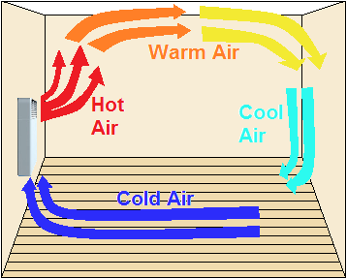
Space heating
Convection heaters

Slide 3
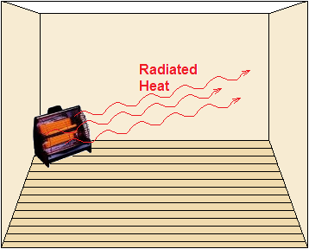
Space heating
Radiant heaters

Slide 4
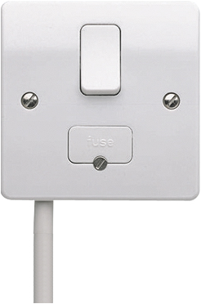
Space heating
Switched fused connection unit with flex outlet

Slide 5
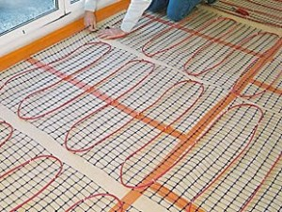
Space heating
Underfloor heating

Slide 6
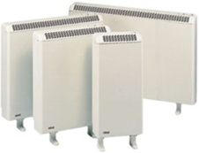
Space heating
Storage heaters

Slide 7
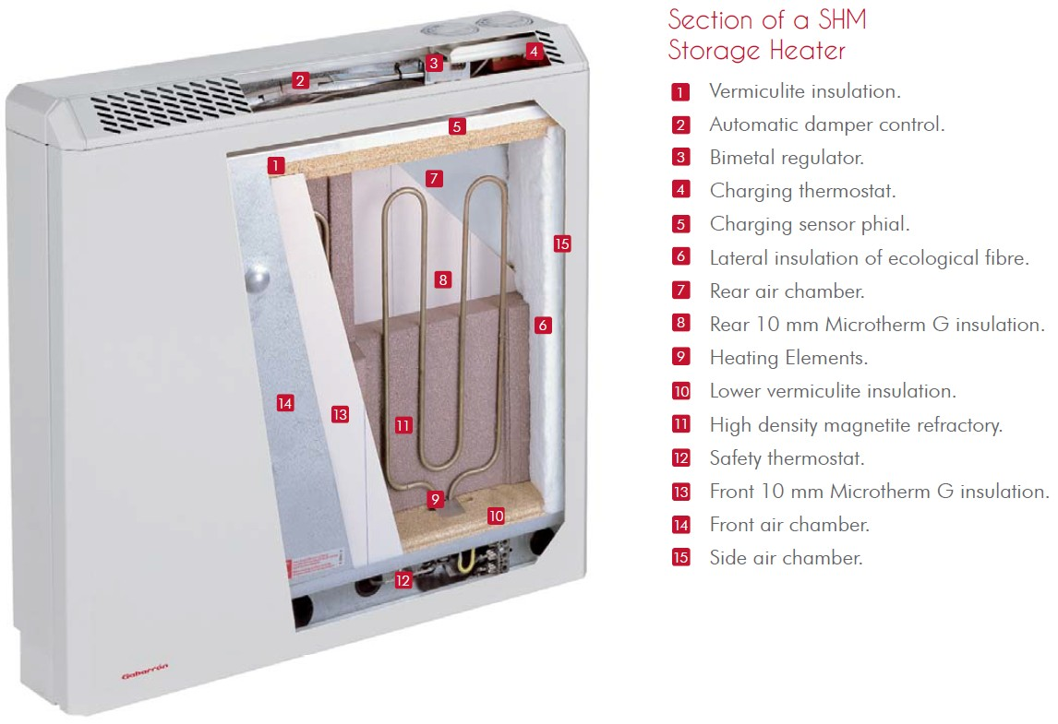
Storage Heater

Slide 8
Unit 203: Electrical installations technology
The End

